Slide 1

Speak fluently
Intermediate

Slide 2
4. At the Hair Salon
There is a proverb that says “Beauty is in the eye of the beholder” which means that not all people have the same opinions about what is attractive.. Do you agree with it?
Do you think beauty is the same for every person?
Do you think that different cultures think about beauty differently?
What do you think of plastic surgery?
Is plastic surgery common in your country?
What does “Beauty is only skin deep” mean? Do you believe in this saying?
What kind of beauty contests are popular in your country?
What makes a person beautiful?
What makes a person ugly?
Do you think the concept of beauty is the same today as it was 100 years ago? If not, how has it changed?

Slide 3
4. At the Hair Salon
How does hair change the way we look?
How much time do you spend in the morning doing your hair?
What would the world be like if no one had hair?
Imagine that during a treatment a hairdresser uses a product that fully resolves your hair problems, but is very expensive. Would you purchase it?
Do you worry about hair loss, thinning hair or grey hair?
Do you dye your hair (or would you dye your hair)?
How often do you look at and arrange your hair every day?
Do you think being a hair stylist is a good job?
What would your dream hairstyle look like?

Slide 4
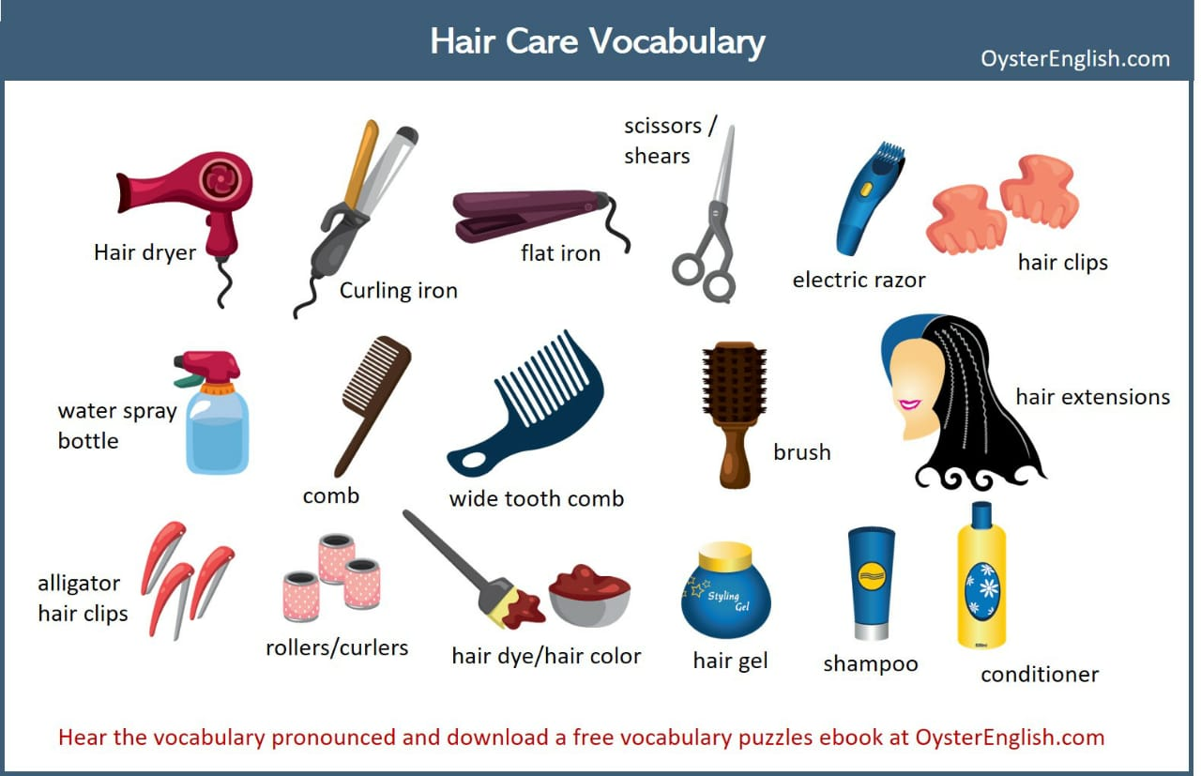
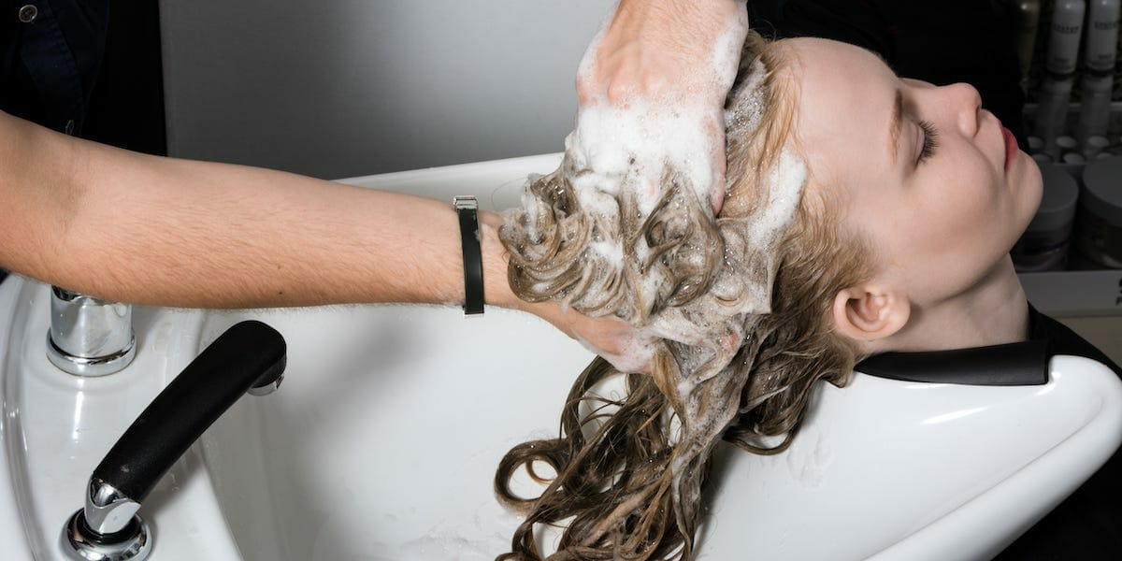
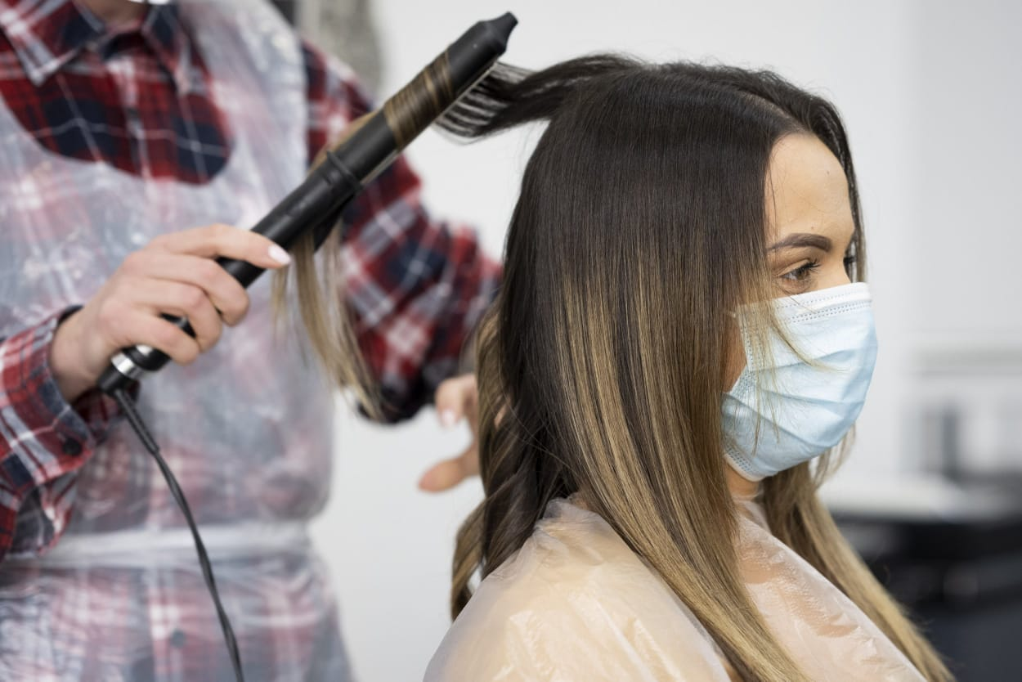
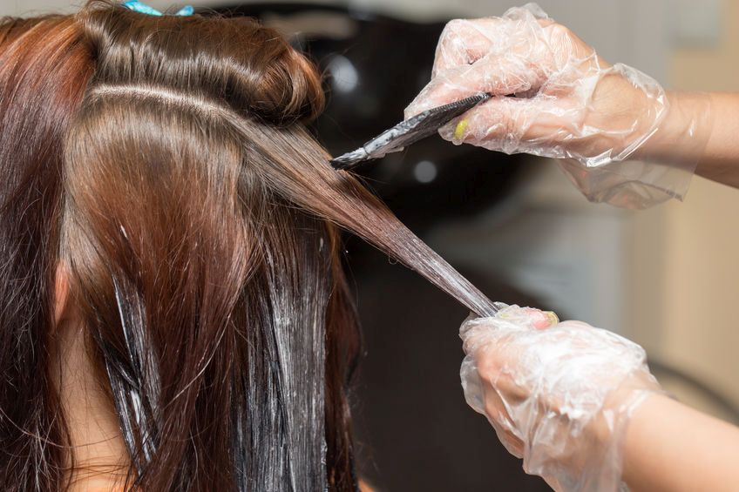
4. At the Hair Salon
I would like to get/have…
a cut
a wash and cut
a wash, cut and dry
a trim
a perm
I’d like to get my hair…
cut
colored /dyed
bleached
streaked
styled
straightened
curled
layered

Slide 5
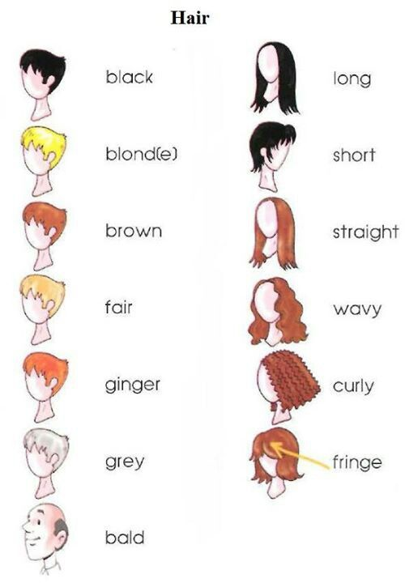
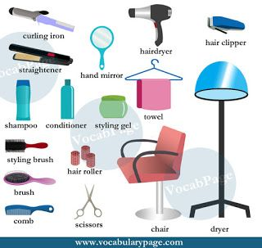
4. At the Hair Salon
Idiom:
To be on top of your game/ at the top of your game : to perform very well so that you couldn’t perform any better
Saying: Beauty is only skin deep
used to say that a person's character is more important than how they look.
Saying: Beauty is in the eye of the beholder.
not all people have the same opinions about what is attractive

Slide 6
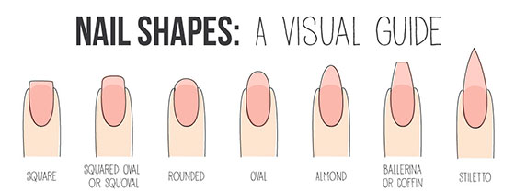
4. At the Hair Salon
Hairdresser – stylist for women
Barber – stylist for men
Barbershop – a place where men get their hair cut
Hair salon – a place where both men and women go for cuts and styles
Hairdresser’s chair – the chair you sit in while you get your hair done
I would like to get my nails done.
Brittle nails –
Nails that easily crack, chip or split .
Wear perfumes- make up

Slide 7
4. At the Hair Salon
Baggy Eyes –
Bags under eyes which need medical attention. They are dark semi circles which are usually raised or swollen under eyes.
Dark circles –
Blemishes around or under eyes that make you look dull.
Puffy Eyes –
Swollen eyes
Blackhead –
Opening on the skin which are covered with dark mass of skin debris.
Freckle and Spots –
Dark black or brown spots that are developed on the skin because of too much exposure to the sun or pollution.
Chapped lips –
Chapped lips means your lips are dry and possibly cracks are formed due to various reasons such as cold weather, too much of exposure to the sun.
Greasy Hair –
Oily hair.
Hair loss –
Losing of hair in abundance

